Slide 1

Active Cyber Defense for Airport Networks
Research Presentation
Nitin Subramaniam
Student ID: 12688734

Slide 2
Research Problem
Airports are more interconnected
More susceptible to cyber attacks
Information sharing
No specific airport cyber security regulation
Gopalakrishnan et al.,2013)

Slide 3
Cyber threats to Airports
Vulnerable to attacks by criminals, terrorists or foreign entities
Insider threats
Not Air-gapped networks
(Lykou, Anagnostopoulou and Gritzalis, 2018)
Dubai Airports Incidents handled (Dubai Airports,2022)

Slide 4
Vulnerability Management
Active and passive discovery
Provide descriptive information
Vulnerability scans
Remediation Plan
Edgar et al., 2019

Slide 5
Insider threat
More visibility
Big data analytics
Chen et al., 2022
Gheyas and Abdallah, 2016

Slide 6
Honeypots
Study adversarial behaviour
Boost threat intelligence
Attractive to attackers
Piggin and Buffey, 2016

Slide 7
Attack Surface Management
Exposed IT assets
Provide constant visibility
Neutralize the exploitations
Combine with CTI
www.cycognito.com, n.d.
Matkowsky, 2022

Slide 8
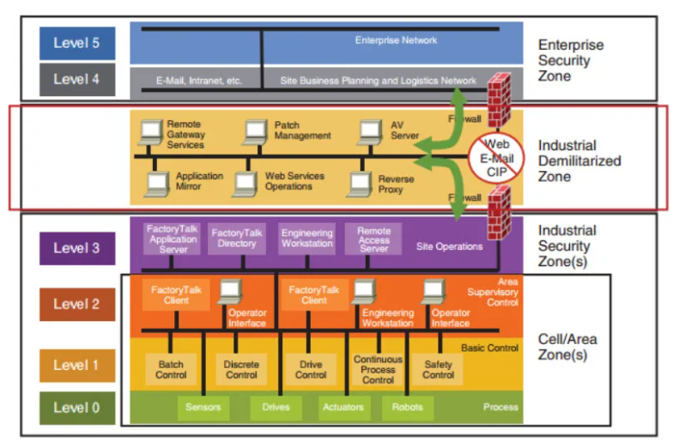
Secure Architecture with IT/OT convergence
Historically separated from IT
Convergence due to data-driven and remote operations
New threats introduced to OT
Purdue model with consideration for IT-OT convergence
Murray, Johnstone and Valli, 2017
Industrial Cyber, 2021
Purdue Architecture (Industrial Cyber, 2021)

Slide 9
Conclusion
Adapt existing cyber norms
Wide cyber security landscape
Growing cyber threats and risks
Lykou, Anagnostopoulou and Gritzalis, 2018

Slide 10
References
Edgar, T., Niddodi, S., Rice, T., Hofer, W., Seppala, G., Arthur-Durett, K., Engels, M. and Manz, D. (2019). Safer and Optimised Vulnerability Scanning for Operational Technology through Integrated and Automated Passive Monitoring and Active Scanning. Journal of Information Warfare, [online] 18(4), pp.125–155. Available from: https://www.jstor.org/stable/pdf/26894697.pdf?refreqid=excelsior%3A02133b68dfdac111c5f17e189eb71eb0&ab_segments=&origin=&acceptTC=1 [Accessed 20 Nov. 2022].
Chen, Q., Zhou, M., Cai, Z. and Su, S. (2022). Compliance Checking Based Detection of Insider Threat in Industrial Control System of Power Utilities. [online] IEEE Xplore. doi:10.1109/ACPEE53904.2022.9784085.
‌‌‌Gheyas, I.A. and Abdallah, A.E. (2016). Detection and prediction of insider threats to cyber security: a systematic literature review and meta-analysis. Big Data Analytics, 1(1). doi:10.1186/s41044-016-0006-0.
Gopalakrishnan, K., Govindarasu, M., W. Jacobson, D. and M. Phares, B. (2013). CYBER SECURITY FOR AIRPORTS. INTERNATIONAL JOURNAL FOR TRAFFIC AND TRANSPORT ENGINEERING, 3(4), pp.365–376. doi:10.7708/ijtte.2013.3(4).02.
‌‌Industrial Cyber. (2021). IT/OT Convergence - The Essential Guide. [online] Available from: https://industrialcyber.co/analyst-corner/the-essential-guide-to-it-ot-convergence/ [Accessed 21 Nov. 2022].
Lykou, G., Anagnostopoulou, A. and Gritzalis, D. (2018). Implementing Cyber-Security Measures in Airports to Improve Cyber-Resilience. 2018 Global Internet of Things Summit (GIoTS). doi:10.1109/giots.2018.8534523.
‌Lykou, G., Anagnostopoulou, A. and Gritzalis, D. (2018). Smart Airport Cybersecurity: Threat Mitigation and Cyber Resilience Controls. Sensors, 19(1), p.19. doi:10.3390/s19010019.
Matkowsky, J. (2022). Threat Intelligence-Driven Attack Surface Management. [online] https://www.researchgate.net/. Available from: https://www.researchgate.net/profile/Jonathan-Matkowsky/publication/362964169_Threat_Intelligence-Driven_Attack_Surface_Management/links/6308ff22acd814437fdae459/Threat-Intelligence-Driven-Attack-Surface-Management.pdf [Accessed 22 Nov. 2022].
‌Murray, G., Johnstone, M. and Valli, C. (2017). The convergence of IT and OT in critical infrastructure. [online] pp.149–155. doi:10.4225/75/5a84f7b595b4e.
‌Piggin, R. and Buffey, I. (2016). Active Defence Using an Operational Technology Honeypot. 11th International Conference on System Safety and Cyber-Security (SSCS 2016). doi:10.1049/cp.2016.0860.
‌www.cycognito.com. (n.d.). What is Attack Surface Management? | CyCognito. [online] Available from: https://www.cycognito.com/attack-surface-management [Accessed 21 Nov. 2022].

Slide 11
Thank you!

